Slide 1
DATA ANALYTICS AT NETFLIX (Evolution from a Video Store to a Movie Recommendation Engine)
Presented by : Ajay Ganapathy

Slide 2
CONTENTS
Traditional Movie Business VS Netflix Generation
Business Models and Netflix’s Challenges
DATA Characteristics, Storage and Processing
Recommendation Algorithm
Conclusion

Slide 3
Traditional Movie Business vs Netflix Generation
People used to buy DVD’s of latest movies from the Video Store.
California based startup had a business idea in mind.
Launched netflix.com on April 14th,1998.
People were able to search for movies online, rent it for a week for few $$.

Slide 4
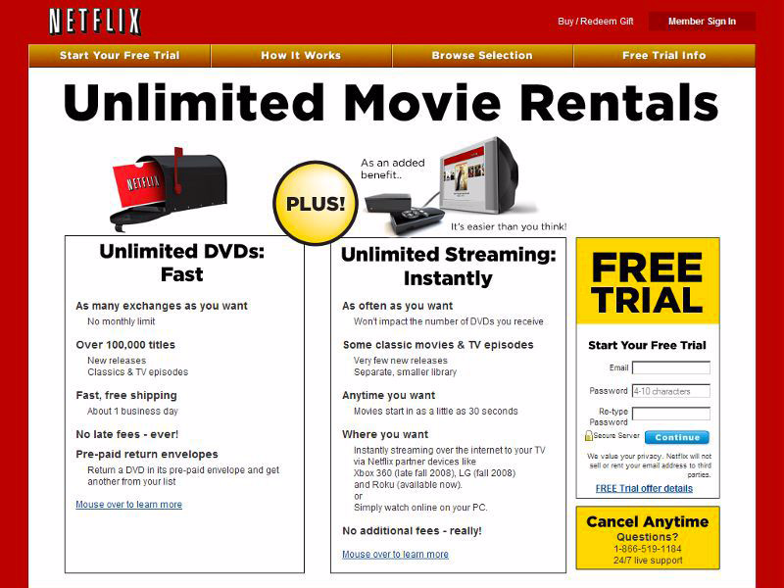
NETFLIX (1999)

Slide 5
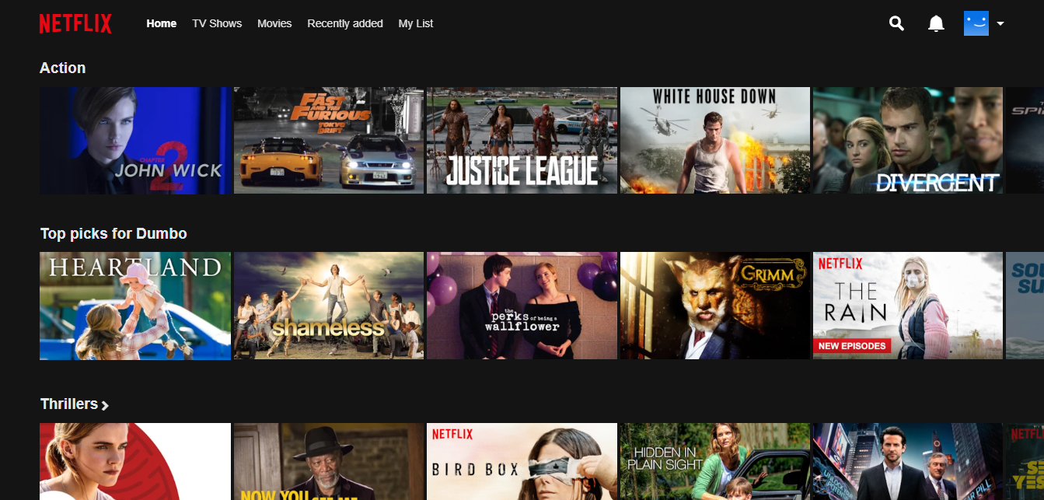
NETFLIX (2019)
- 117 Million subscribers
- 5500 employees
- 11 billion $ revenue (2017)
- 135 billion $ Net revenue

Slide 6
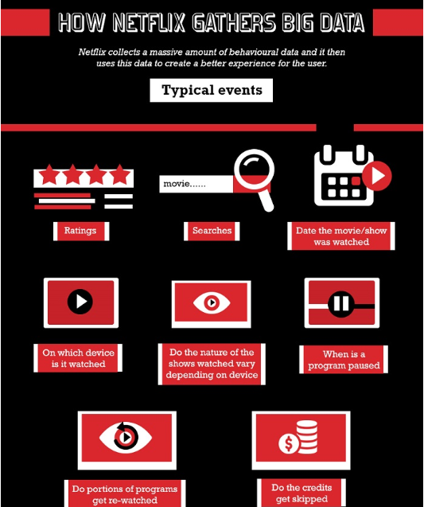
Analytics at NETFLIX
User Insights
Tracks user data
Analytical Roles
Data Scientist
Data Engineer
Data Analyst
Machine Learning Engineer

Slide 7
Business Models & Netflix Challenges
How Netflix generates revenue ?
- Subscriptions (basic, standard, premium ranging from 10 to 18$)
How Netflix benefits Users ?
- Technology : watch content on any kind of device
- Comfort : Mobile Application
- On demand : Content accessible anytime, anywhere
- Data Driven : Content that fits user preferences
NETFLIX Challenges
Market expansion, more content, high costs
- Different pricing structures, Average income varies as per region
Slow and Expensive internet services in few developing markets

Slide 8
DATA Characteristics, Storage and Processing
DATA Characteristics
- the four V’s (volume, velocity, variety, veracity)
DATA Storage
- Used to host content on third party providers once
- Developed their own CDN where all movies are cached and delivered
- 36 hard drives that can withstand 100 TB of data
- Servers are able to store and stream 10k to 20k movies simultaneously

Slide 9
Thousands of servers set up across the globe
off hours – Prepopulates movies and series thereby reducing bandwidth during peak hours
- Petabyte worth of content
Content collected overtime and streamed when called by user
ISPs help media to reach to the users from CDN
Netflix AI – Netflix tracks the location from where user logs in and decides which location in relation to you the movie should be streamed from.

Slide 10
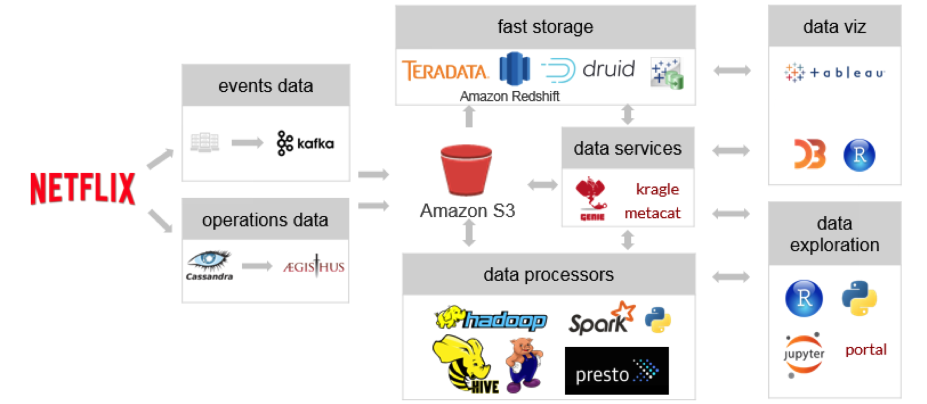
Data Flow

Slide 11
Recommendation Algorithm
Collaborative Filtering
Dislike if user pauses or leaves
Like if user binge watched the entire series
Filters movie genres and movies that you will enjoy and personalizes the content.
Incase of a cancelled show, if users have binge watched the entire series, it may provoke some interest in Netflix to restart the series.
Based on the trends and user insights, Netflix is confident.
Filtering similar users, Netflix recommends movies/TV Series.

Slide 12

CONCLUSION
Thus, called the world’s famous online Video Store
…… To all the binge watchers,
COMING SOON ;)

